Slide 1
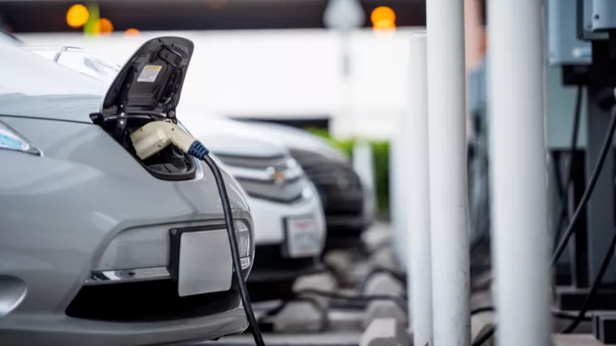



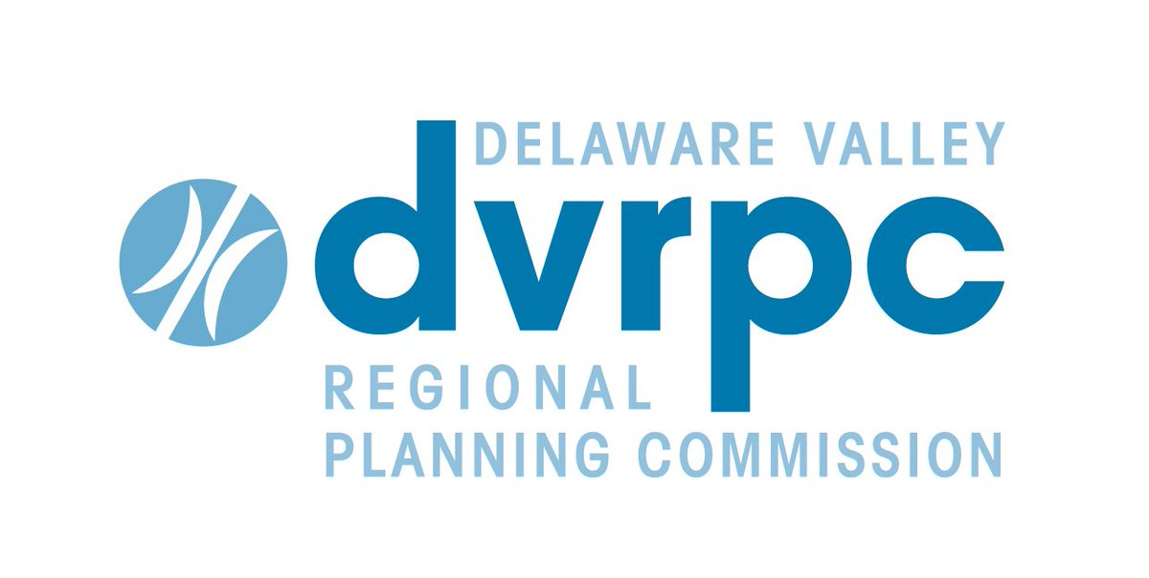



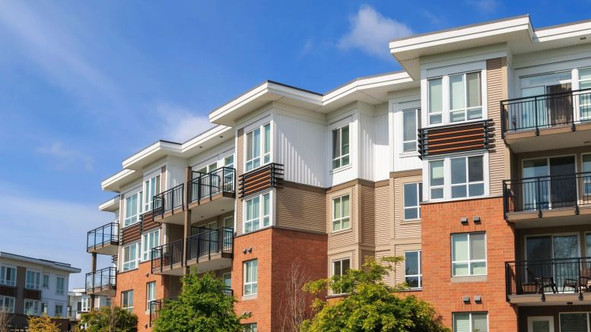
Contribution Analysis: How Regions Can Track Progress in Greenhouse Gas Mitigation
Presenters:
Eli Yewdall, Senior Technical Officer, ICLEI USA
Maia Davis, Senior Environmental Planner, Metropolitan Washington Council of Governments
Rob Graff, Manager, Office of Energy and Climate Change Initiatives, Delaware Valley Regional Planning Commission
National Association of Regional Councils

Slide 2
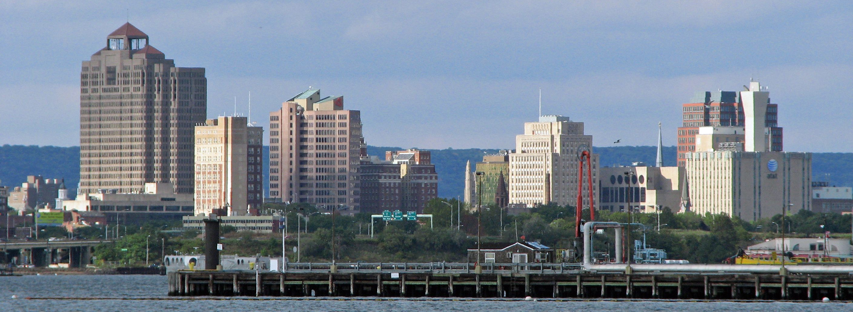
Regional GHG Management Tools August 20, 2019
[Insert photo goes here]

Slide 3
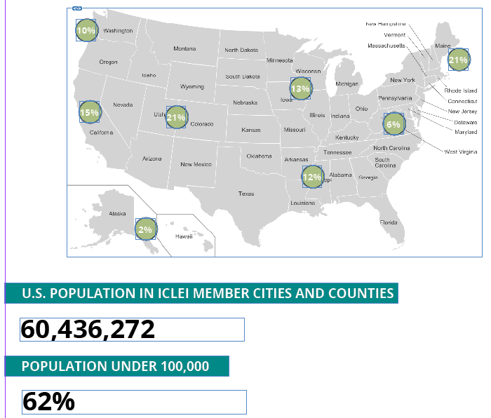
ICLEI Network at a glance
ICLEI USA network

Slide 4

ICLEI brings sustainability planning into communities through:
• Convenings
• Peer-city networks
• Cohort Trainings
• Tools & Protocols
• Resources and Best Practices

Slide 5




ICLEI is your peer-city network
Renewable Energy
Biodiversity and nature-based solutions
Regional food systems
Sustainable procurement

Slide 6
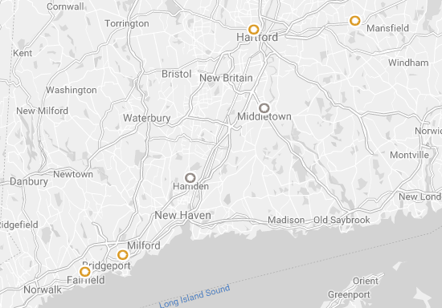
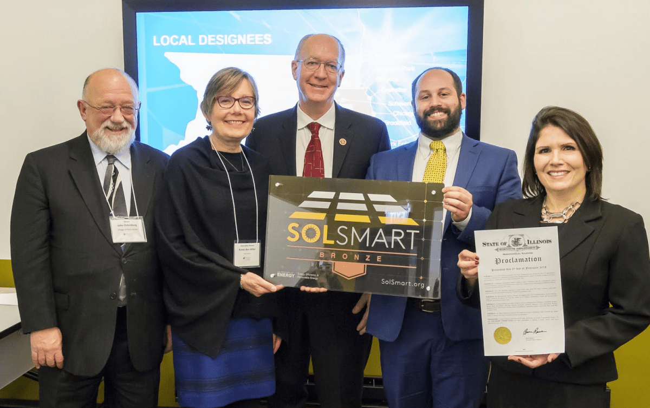


Slide 7
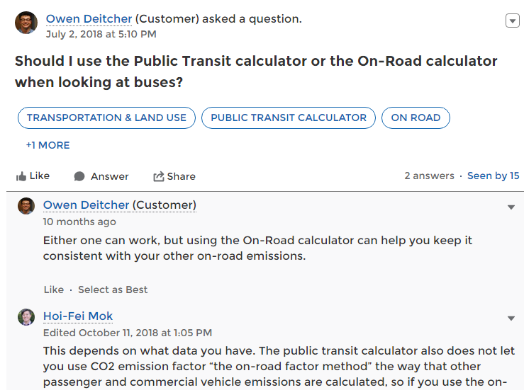
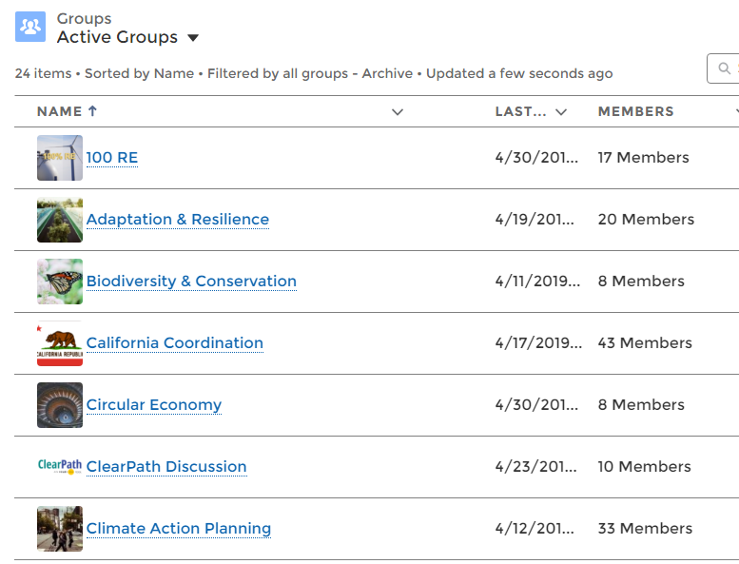
ICLEI Community portal

Slide 8
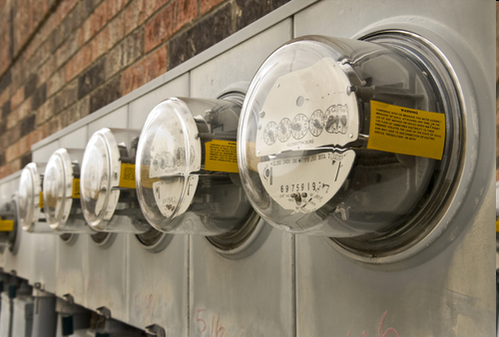
Why is a GHG Inventory Important?
You can’t effectively reduce what you don’t measure!
Two main uses:
Know largest emissions sources
Target most effective reduction actions
Target energy/cost savings actions
Track GHG emissions performance over time
Notes:
Your community GHG inventory is a small but important piece of the global effort to reduce greenhouse gases from human sources to the point where they are in balance with what can be absorbed by natural systems and the climate can stabilize. Your inventory will allow your community to plan and measure the impact of local actions.

Slide 9
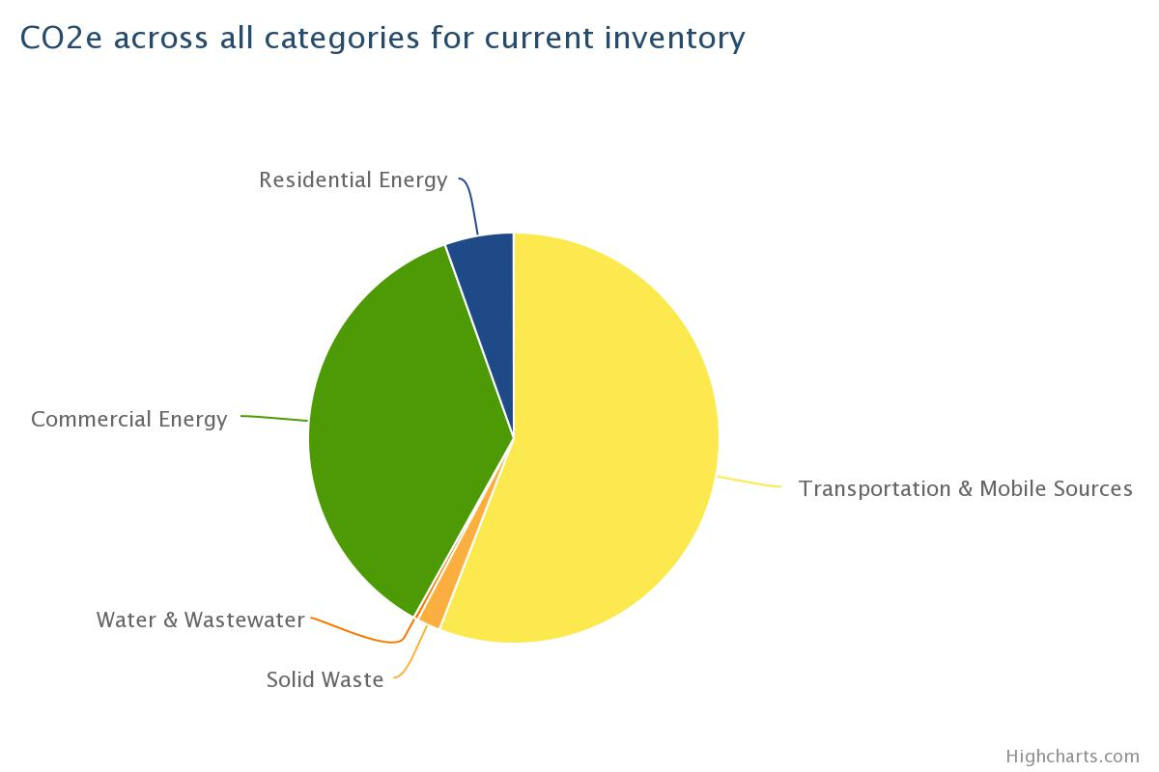
Example 1: Planning
Notes:
For example, let’s take a look at what results of a community inventory might look like. For this community, you can see that actions focusing on transportation and commercial energy have the greatest potential to reduce overall emissions.

Slide 10
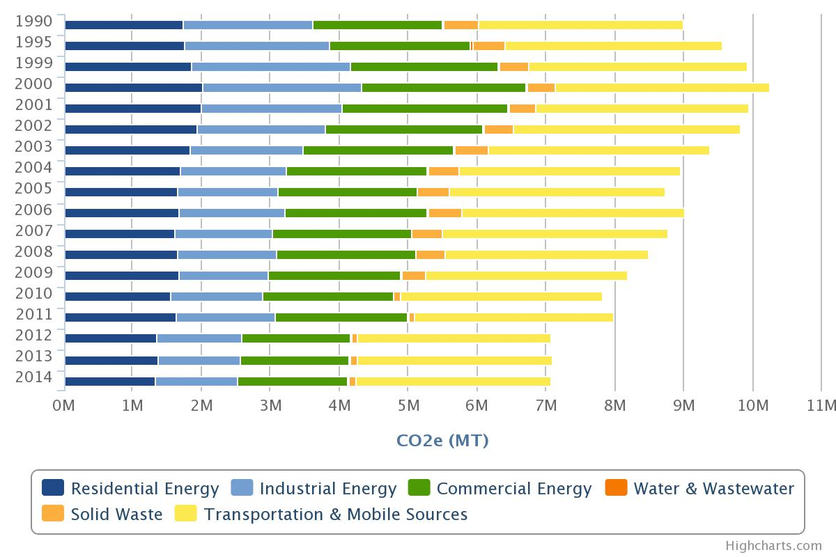
Example 2: Tracking Progress
Notes:
Secondly, once you have completed inventories for multiple years, you can compare those to see results of any programs or policies that may have been introduced to try to save energy and reduce emissions.

Slide 11
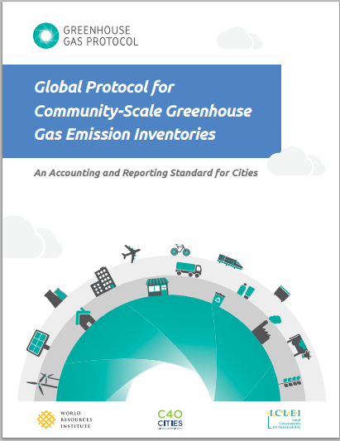
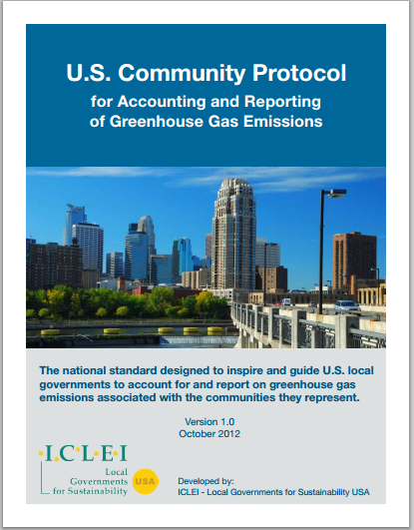
Community Inventory Protocols
Notes:
-When we refer to the “protocols”, we are referring to two protocols used for conducting inventories: The U.S. Protocol and the Global Protocol. ICLEI was involved in writing both of them. Both are embedded in the ClearPath tool and goal of the session is to help your inventory comply with both.

Slide 12

Inventory
Forecast
Planning
Monitoring & Tracking
Reports

Slide 13
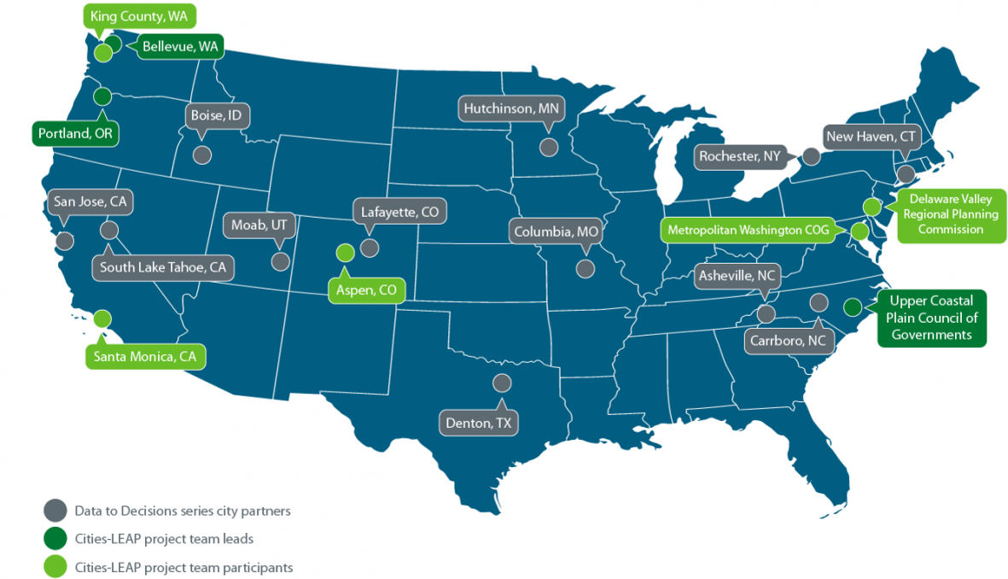
Department of Energy Cities-LEAP
Cities Leading through Energy Analysis and Planning

Slide 14
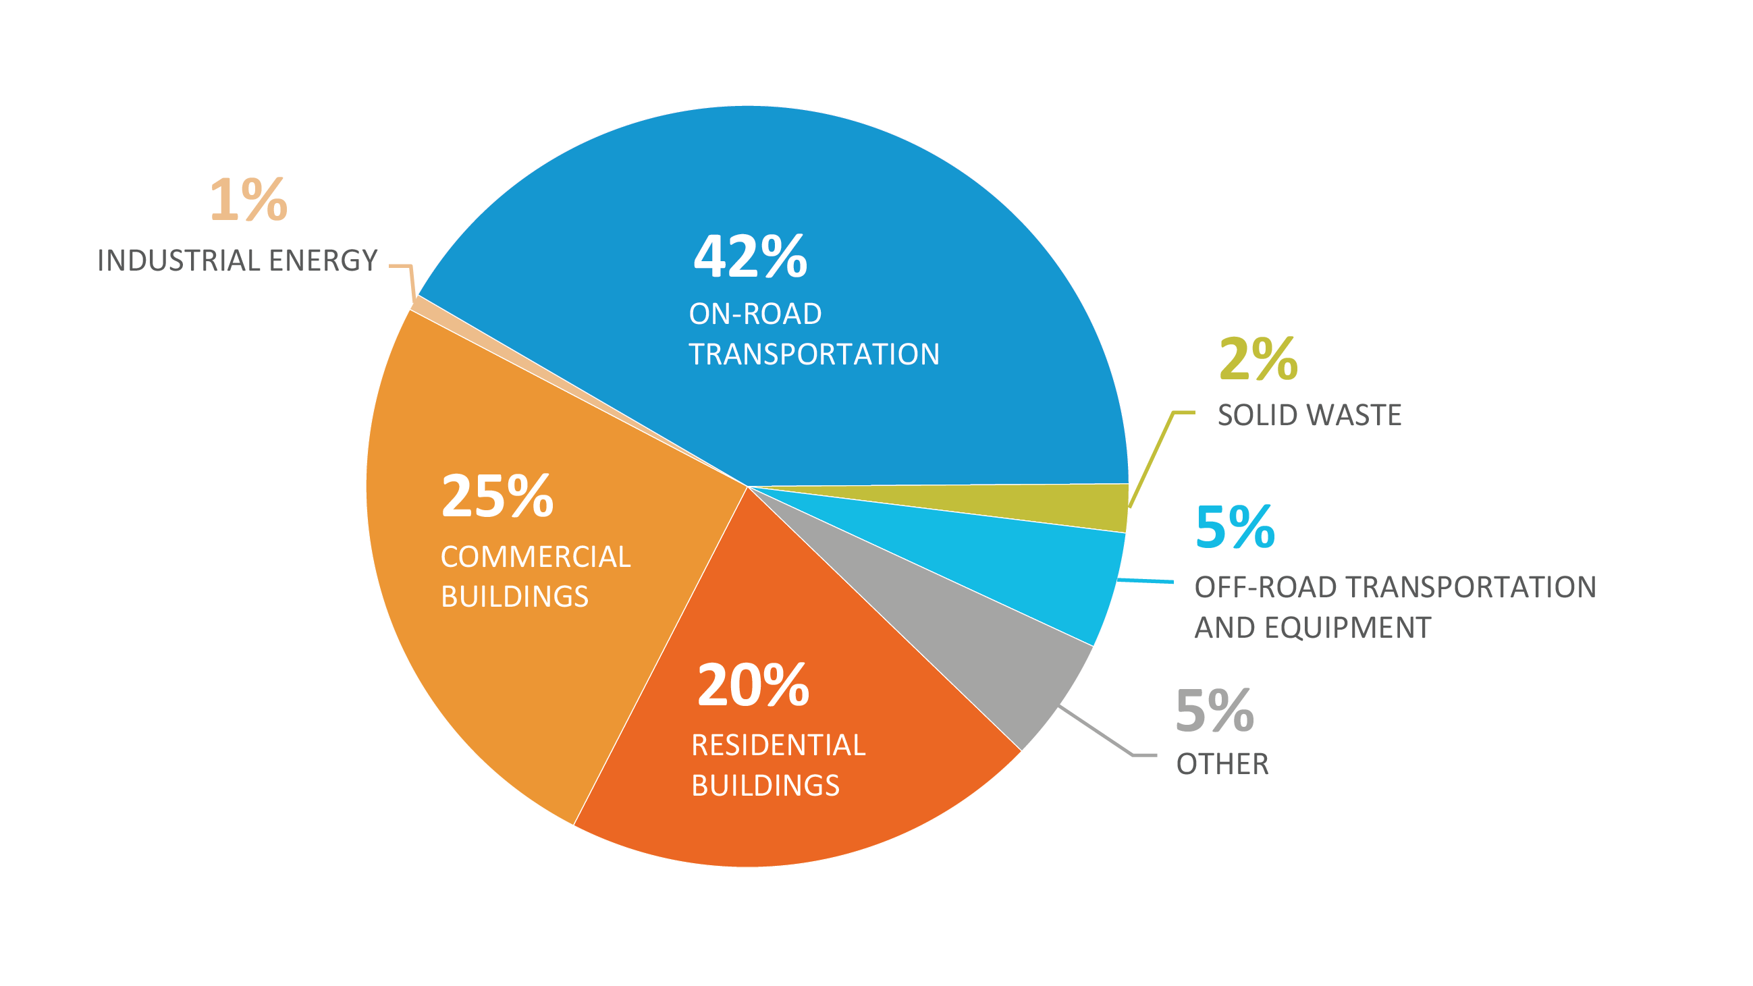
One Inventory Tells You:

Slide 15
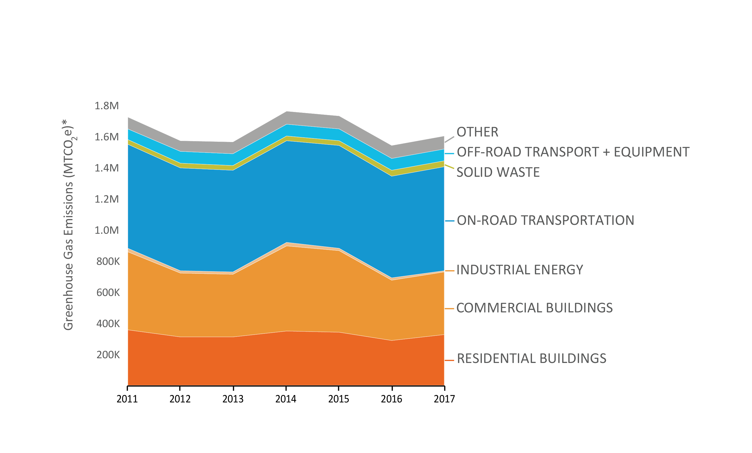
Multiple Inventories Tell You:
*MTCO₂e = metric tons carbon dioxide equivalent

Slide 16
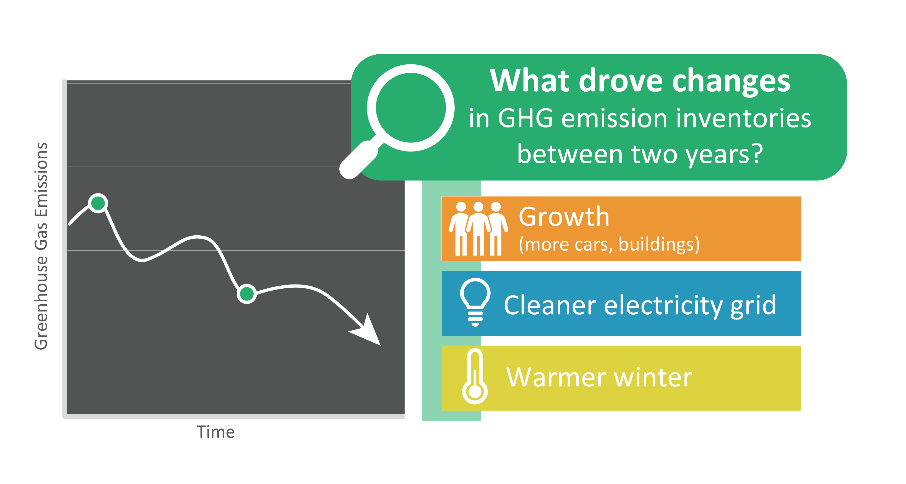
Missing Information

Slide 17
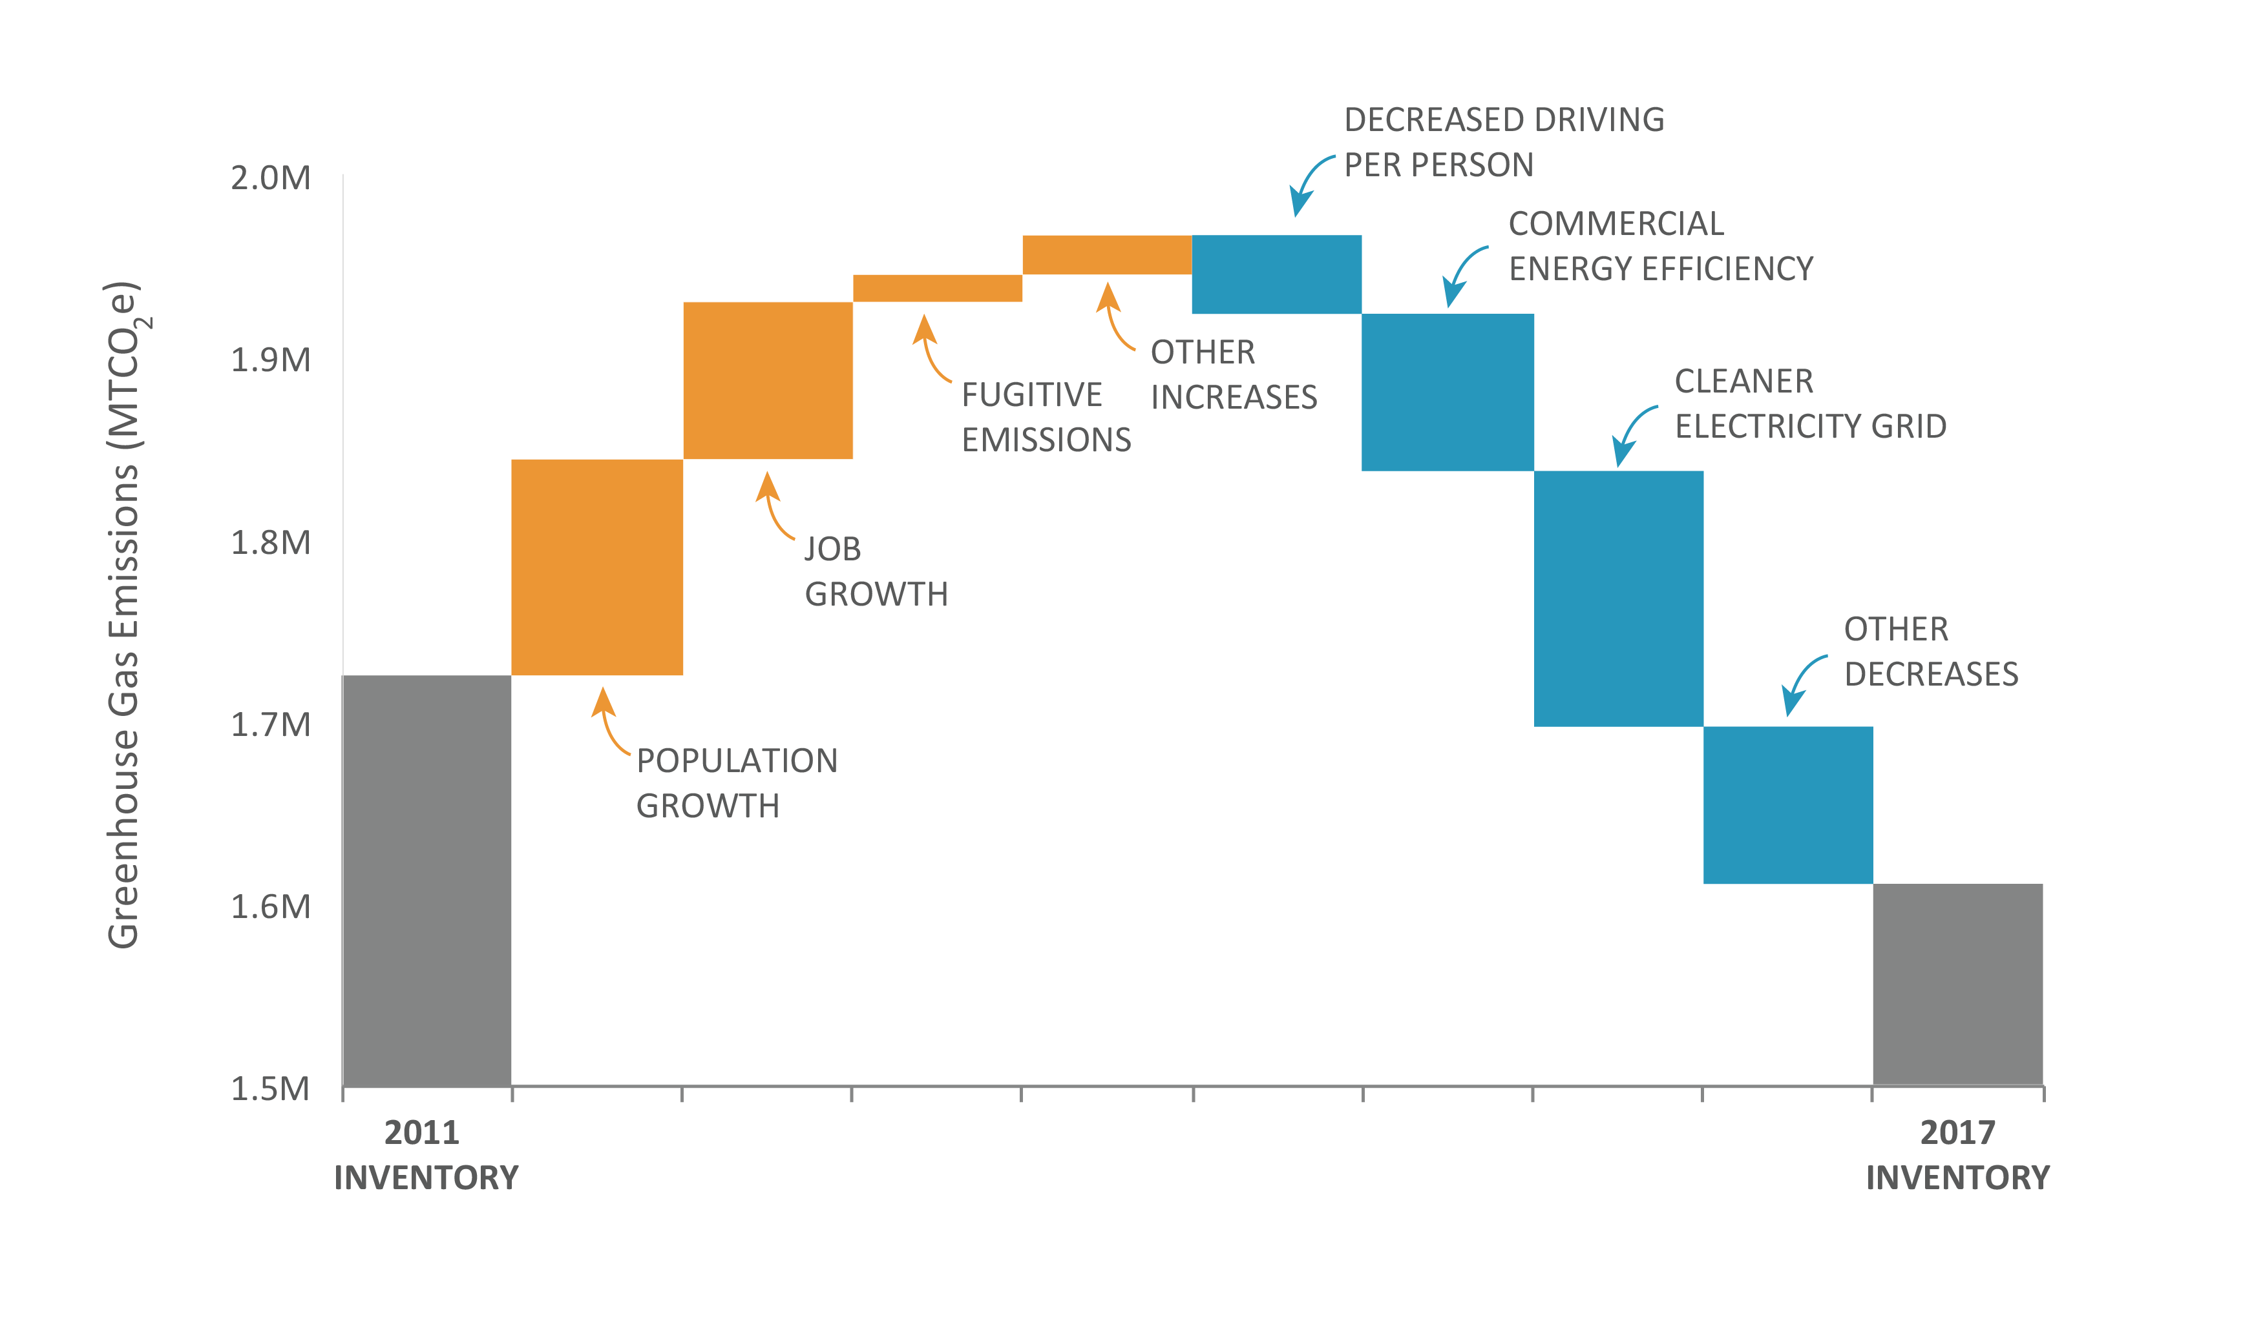
Filling the Gaps

Slide 18
Demonstration Cities
Steering Committee:
King County, WA
Bellevue, WA
Santa Monica, CA
Aspen, CO
Metro Washington Council of Governments
Delaware Valley Regional Planning Council
Second Round Cities
Hayward, CA
Nashville TN
Cleveland, OH
Denver, CO
Miami-Dade County, FL
Durham, NC
Olympia, WA
Shoreline, WA
Ashland, OR
Notes:
Introduce the project (put in a plug for CLEAP hear: What is the program, how funded, other things that CLEAP is producing, at this link: https://energy.gov/eere/cities-leading-through-energy-analysis-and-planning).

Slide 19
Types of Changes
Inventory Inputs
Emissions Factors, Fuel Economy
Operating Conditions
Weather, Economic Environment
What is in the community
Population, Building Area
Local Action

Slide 20
What the Tool Does
Change to Inventory Inputs
Separates the relative impact of Emissions Factor and Total Activity
Change to Operating Conditions
Determine relationship between weather and city performance to account for change
Change to what’s in the Community
Simple “per-capita”, “per-employment”
Local Action
Subtract the remainder

Slide 21
Data Needs
Two inventories
consistent methods
Demographic data (federal sources):
# of households, commercial ft2 or employment, GDP/person

Slide 22
Data Needs to Account for Weather
Develop relationship between weather and community energy use with regression techniques
Need monthly electricity, natural gas usage
Daily weather—available from National Climate Data Center

Slide 23
Local Programs
Need to have already performed an evaluation of the action
Limit the analysis to the time period between inventories
The tool puts the reductions in the overall framework

Slide 24
Toolkit Overview
http://icleiusa.org/ghg-contribution-analysis/
Downloadable Zip File
Excel workbook tool
Quick Start Guide (data collection and entry)
Full Guide
Online training (concepts, data collection and entry)
Data request templates
Data collection checklist

Slide 25

Eli Yewdall
Senior Technical Officer eli.yewdall@iclei.org
404-937-3000
ICLEI USA Headquarters
1536 Wynkoop St #901
Denver, CO 80202
(510) 844-0699
icleiusa.org
@ICLEI_USA

Slide 26
Greenhouse gas DRIVERS OF CHANGE
Metropolitan Washington Contribution Analysis
Maia A. Davis Senior Environmental Planner NARC Webinar August 20, 2019

Slide 27
Metropolitan Washington Council of Governments
District of Columbia, northern Virginia, suburban Maryland
24 local government members
300+ elected officials
Region Forward Vision: Working together towards a more prosperous, accessible, livable and sustainable future

Slide 28



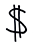



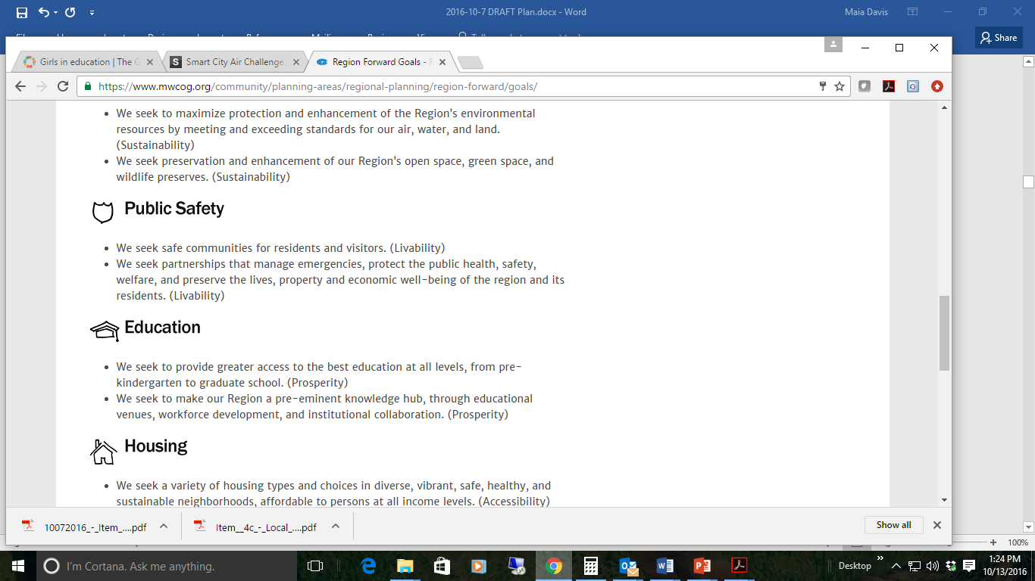
Region Forward Goals
Climate and Energy
Decrease GHG emissions; efficient use of energy; reliance on renewables
Environment
Maximize protection and enhancement of environmental resources
Transportation
Enhance transportation choice and connectivity; minimize ecological harm
Land Use
Enhance established neighborhoods; preserve resource lands; growth in Activity Centers
Housing
Variety of housing types and choices in sustainable neighborhoods
Economy
Diverse, stable, competitive economy; minimize disparities
Health and Human Services
Every person enjoys health and well-being
Education
Access to all levels of education; Make our region a pre-eminent knowledge hub
Public Safety
Safe communities; preserve lives, property and economic well-being residents

Slide 29
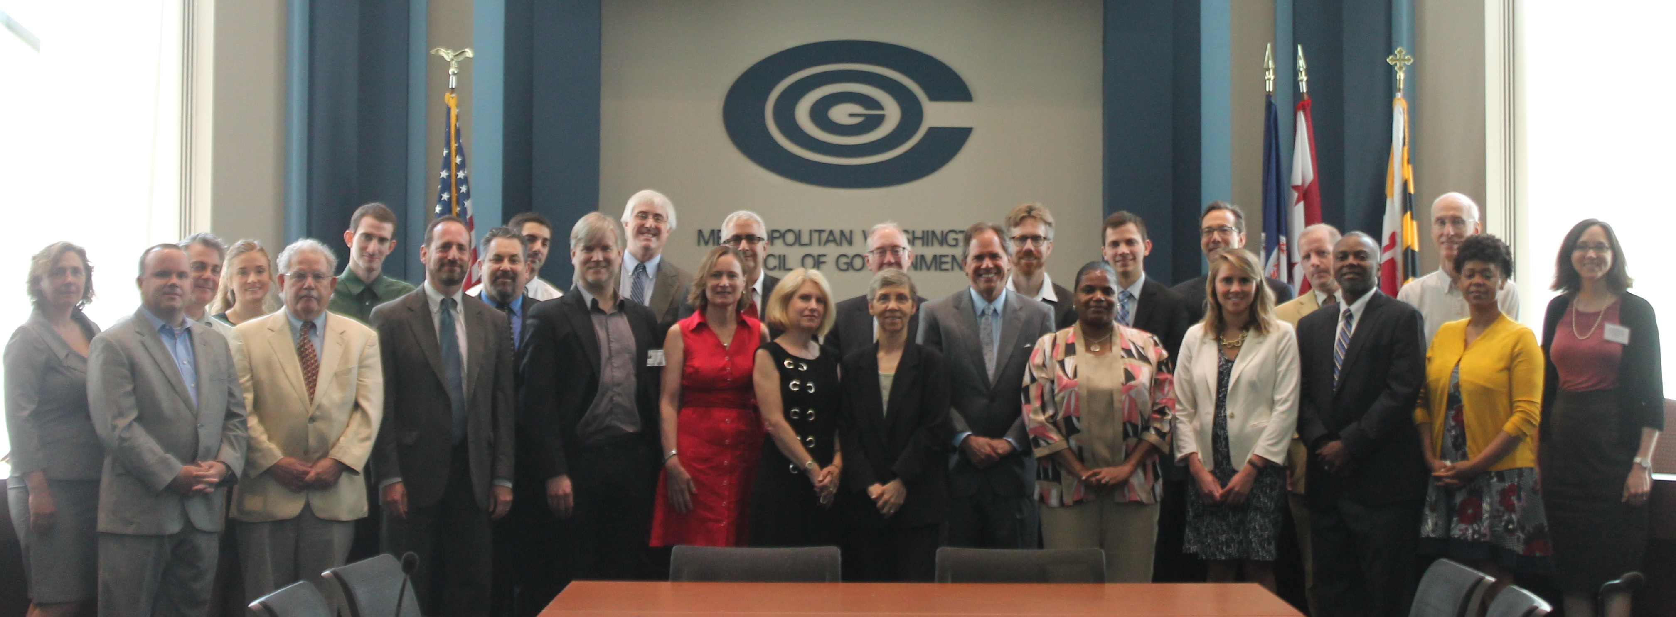
Regional Climate & Energy Program
One of the nation's first initiatives to address heat-trapping emissions on a regional level.
Provides roadmaps, tools, technical assistance, and resources to communities seeking more sustainable options for growth and development.
Climate, Energy and Environment Policy Committee (CEEPC) works together to meet local and regional GHG goals.

Slide 30
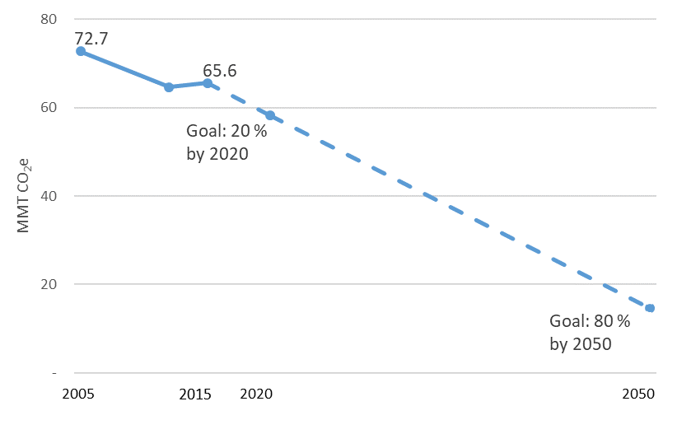
Metropolitan Washington GHG Goals

Slide 31
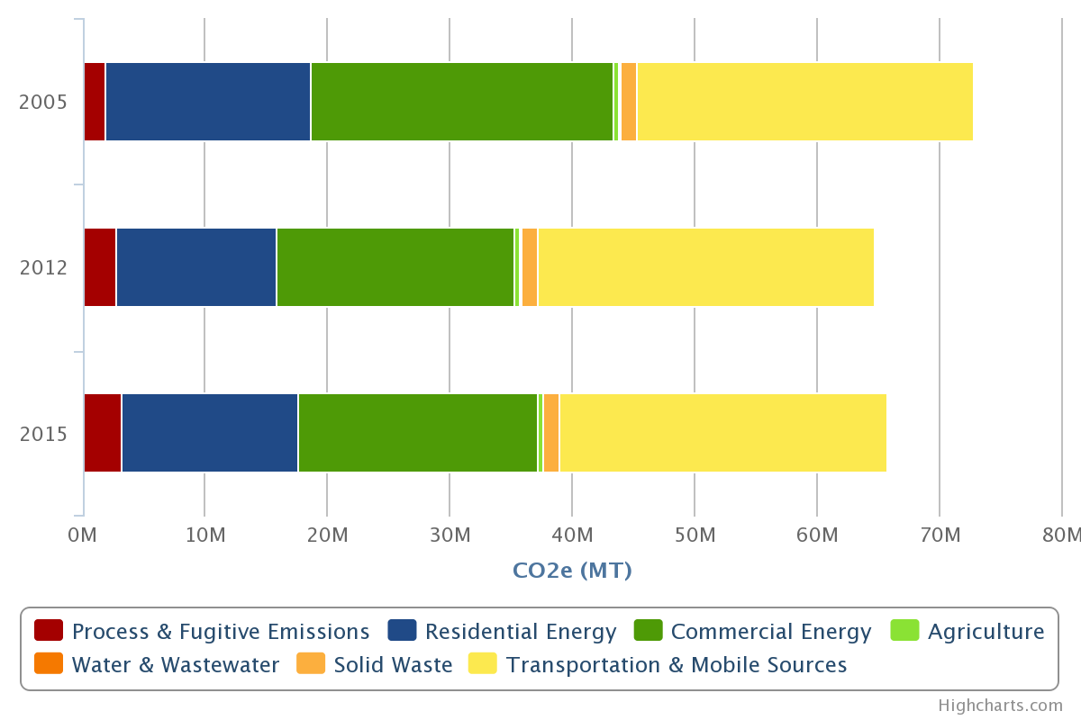
Metropolitan Washington GHG Trends
10% reduction in GHG emissions, 2005 - 2015

Slide 32
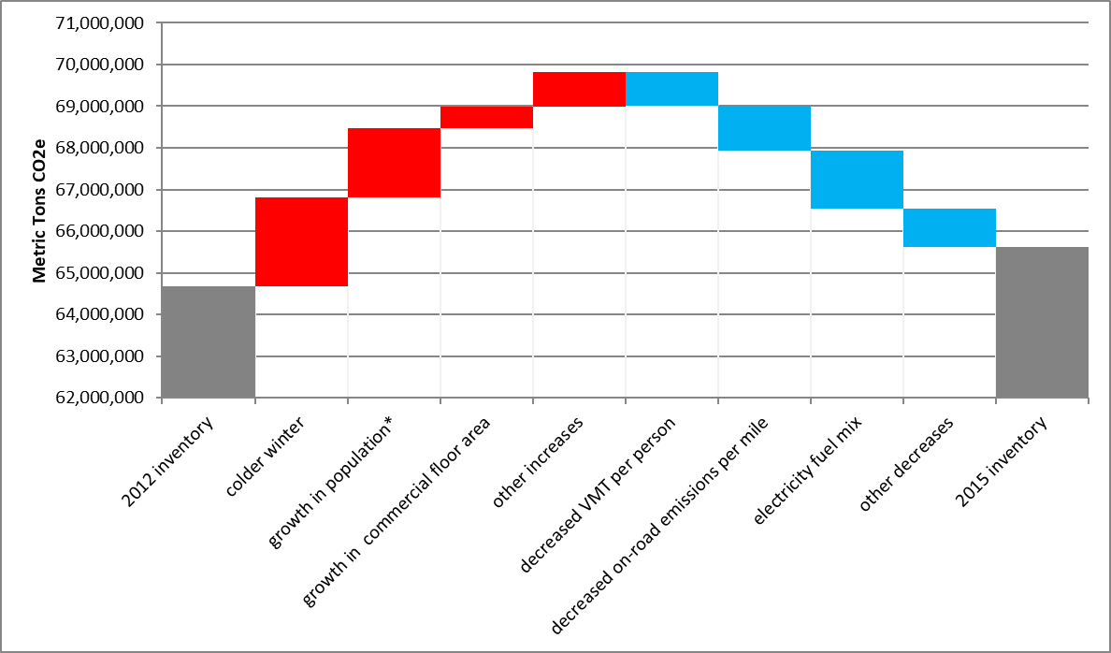
Metro Washington Drivers of Change

Slide 33
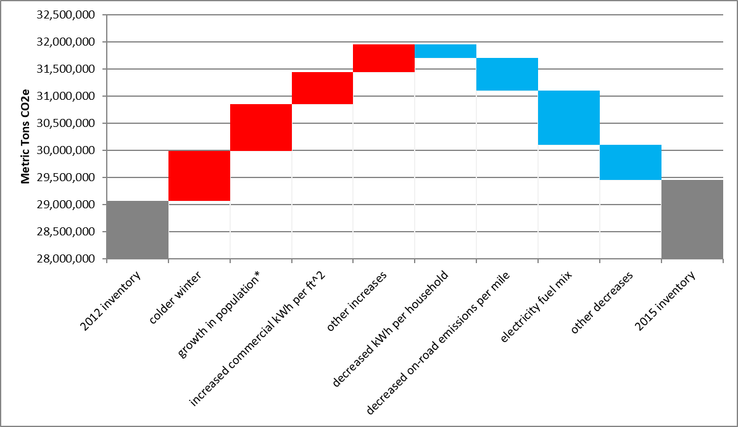
Local Community A - Drivers of Change

Slide 34
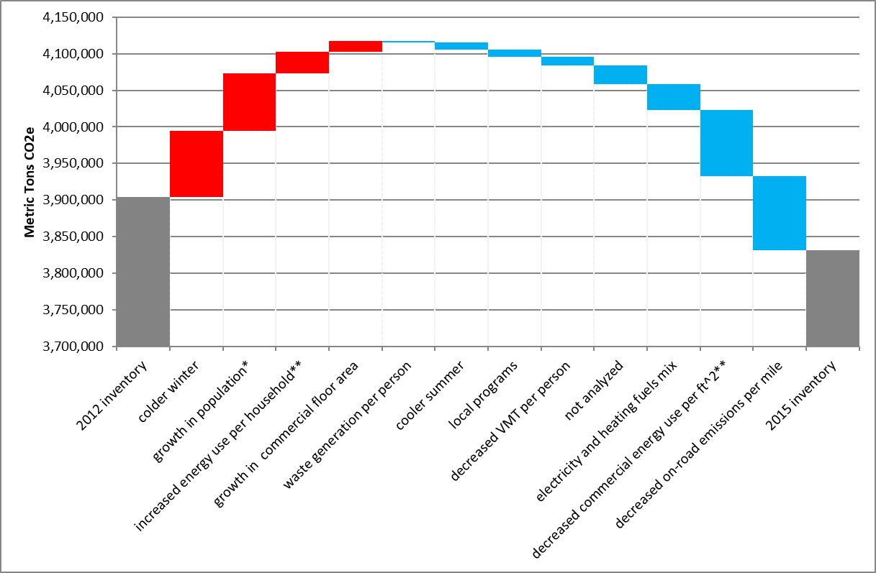
Local Community B - Drivers of Change

Slide 35
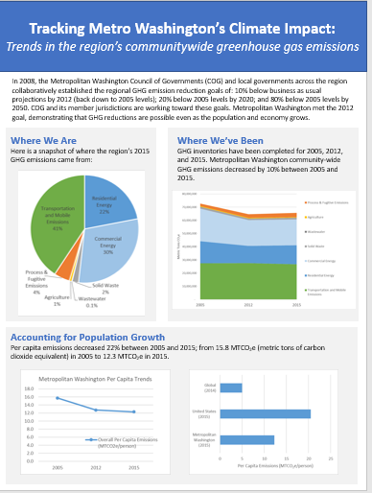
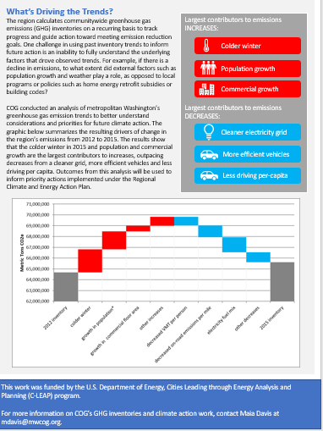

Slide 36
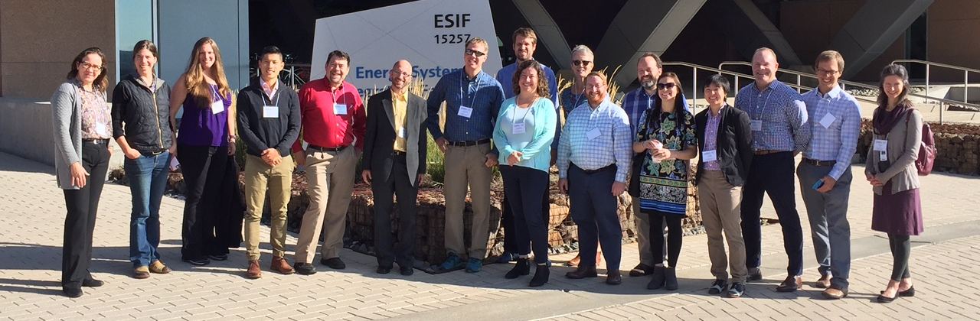
Maia A. Davis Senior Environmental Planner (202) 962-3227 mdavis@mwcog.org | mwcog.org
777 North Capitol Street NE, Suite 300 Washington, DC 20002

Slide 37
Attribution Analysis: Greenhouse Gas Emissions in Greater Philadelphia
NARC Webinar: “Contribution Analysis: How Regions Can Track Progress in Greenhouse Gas Mitigation”
August 20th, 2019
Robert Graff
Manager, Office of Energy and Climate Change Initiatives
Delaware Valley Regional Planning Commission

Slide 38
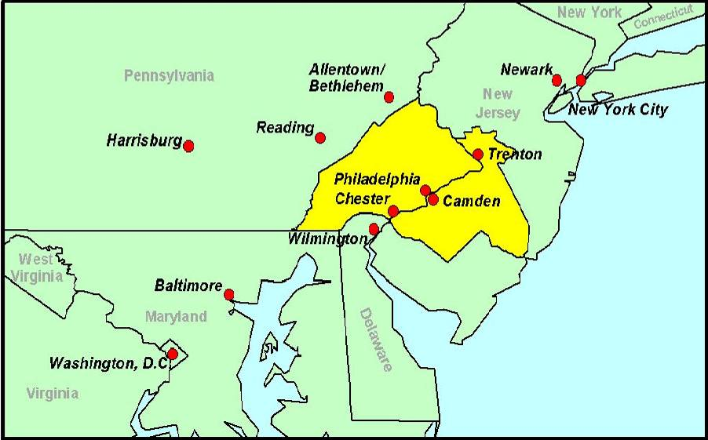
Delaware Valley Regional Planning Commission (DVRPC)
Metropolitan Planning Organization (MPO) for Greater Philadelphia region
Board comprised of representatives of the counties, major cities, key state agencies, and governors’ offices
Notes:
DVRPC is the Metropolitan Planning Organization or MPO for Greater Philadelphia. This region includes the City of Philadelphia and eight surrounding counties in Pennsylvania and New Jersey. Our board, the Commission, is composed of representatives of these counties, the major cities in the region, and the two states. MPOs, like DVRPC, are primarily transportation planning organizations, and our Board plays a key role in deciding how federal transportation funding gets spent in the region. In order to ensure this investment meets long term regional goals, we are required to develop a long range plan, which by its nature touches on more than just transportation.
As of 2015, the Greater Philadelphia region was home to about 5.7 million people. There are 351 municipalities in the region, all with strong home rule. That means land use and many other decisions are made at the local level. Thus as MPO staff, we seek to develop helpful planning tools, communicate information and best practices, and generally support our counties and municipalities in creating better futures for their residents. But, we have really no authority over policy, except for federal transportation spending.

Slide 39
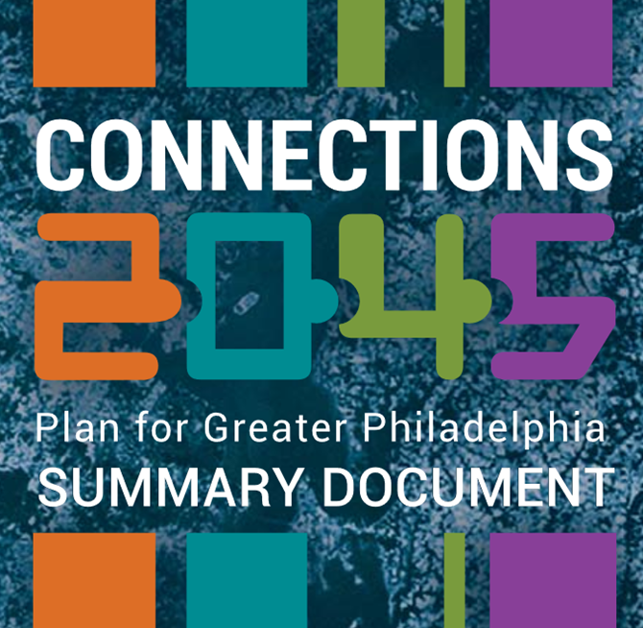
Connections 2045: Plan for Greater Philadelphia
The region’s long-range plan
Sets a goal of reducing GHG emissions by 60% from 2005 levels by 2040
Notes:
The region’s long-range plan, Connections 2045: Plan for Greater Philadelphia, repeats the previous long range plan’s goal of reducing greenhouse gas emissions by 60% from 2005 levels by 2040. This is in line with related commitments made by governments in the region. For example, the City of Philadelphia has adopted a reduction target of 80% by 2050. This 80 by 50 goal is often cited as what is needed to limit the global temperature increase to no more than 1.5 degrees Celsius above pre-industrial levels.

Slide 40

DVRPC Areas of Activity
Transportation, Air Quality, Smart Growth, Environmental Planning, Housing and Economic Development, Population and Employment forecasts, Long Range Planning, and…
Energy and Climate Change Initiatives:
Understand and advance effective and practical policies to reduce greenhouse gas emissions and prepare the region for the inevitable long-term impacts of climate change, with a particular focus on the transportation sector.
Notes:
DVRPC has a number of areas of activity. I managed the office of Energy and Climate Change Initiatives. My office’s mission is both to understand in advance effective and practical policies for reducing greenhouse gas emissions, and to prepare the region for the inevitable long-term impacts of climate change, particularly regarding the transportation sector.

Slide 41
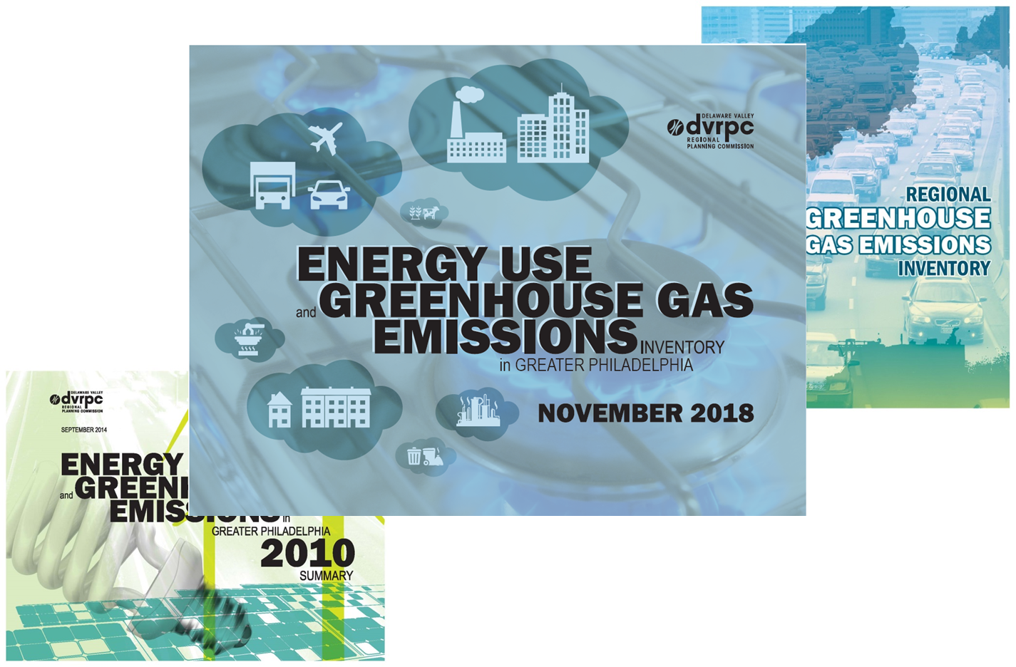
Energy Use and Greenhouse Gas Emissions Inventories for Greater Philadelphia
Notes:
In order to track progress towards its greenhouse gas reduction goal, as well as help shape and inform local energy use and greenhouse gas emissions reduction strategies, DVRPC periodically carries out an inventory to estimate energy use and greenhouse gas emissions for the region. Our most recently completed inventory, for calendar year 2015, published in November 2018.
Provide snapshots of energy use and GHG emissions
Available for 2005 and 2010 as well.
Show trends in energy use and emissions
Helps to shape energy use and emissions reduction strategies

Slide 42
Emissions by Sector (2010)
Notes:
In 2015, stationary energy use in commercial, industrial, and residential applications dominated annual greenhouse gas emissions, resulting in about 43.4 MMTCO2e or 57.6% of the region’s gross emissions of 75.3 MMTCO2e. Mobile energy use, primarily transportation, contributed another 23.1 MMTCO2e or 30.7% of the region’s gross emissions. Altogether, energy use accounts for just under 90% of regional gross GHG emissions.

Slide 43
Electricity Generation Mix
Notes:
In the past we were able to make some broad brush statements about the different factors driving changes in emissions from inventory to inventory. For instance, we could easily compare the electricity generation mix from year to year . . . [Next slide]

Slide 44
Electricity Generation Mix
Notes:
. . and note how the shift away from coal to natural gas over the course of our carrying out inventories . . . [Next slide]

Slide 45
Electricity Generation Mix
1146 lbs. of CO2e
per MWh
1007 lbs. of CO2e
per MWh
835 lbs. of CO2e
per MWh
Notes:
. . . reduced the GHG emissions associated with electricity use.

Slide 46
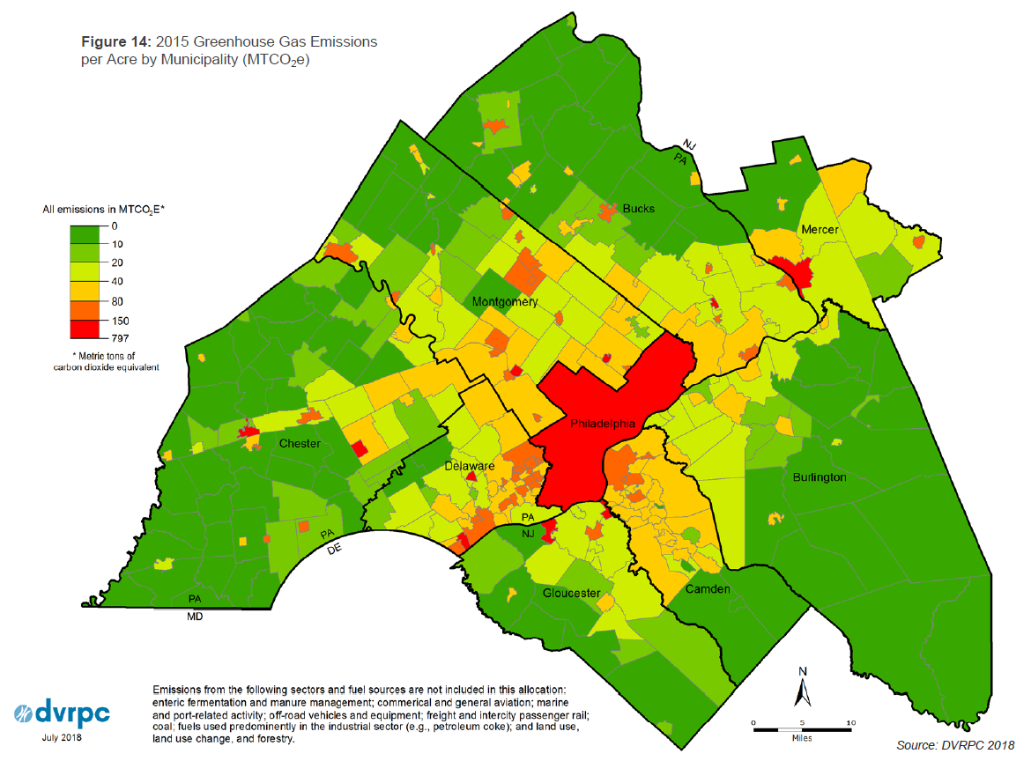
Municipal Allocations of Greenhouse Gas Emissions (2015)
Per Acre
Notes:
We could also look at general trends.
In addition to providing region-wide estimates, we also allocate energy use and emissions to our counties and municipalities. This can also help to better understand region-wide trends. Though densely settled communities tend to have higher emissions per acre (seen in this map), . . . [next slide]

Slide 47
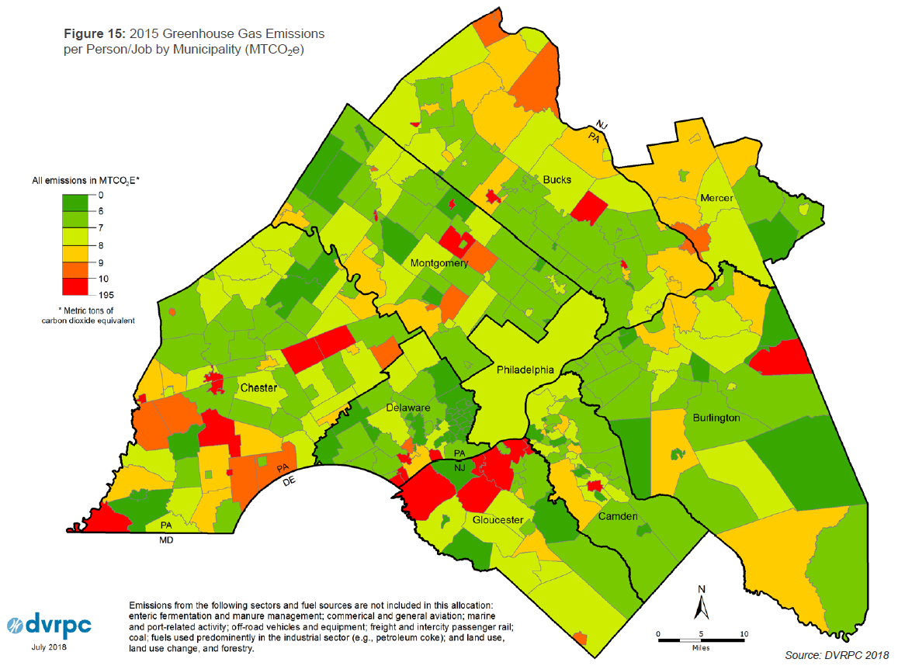
Municipal Allocations of Greenhouse Gas Emissions
Municipal Allocations of Greenhouse Gas Emissions (2015)
Per Capita
Notes:
. . . often have some of the lowest emissions per capita. In general, you can draw from this the correlation between dense settlement patterns and everything that goes along with them, including transit service and walkability, and lower emissions profiles.
But, what we couldn’t do or weren’t doing was taking a more nuanced look at the many different factors at play between inventories.

Slide 48
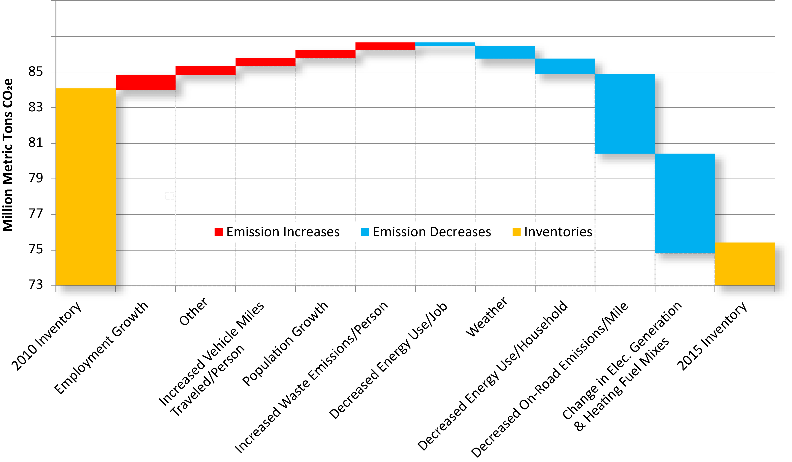
Contribution Analysis (2010-2015)
Notes:
The outputs from ICLEI’s contribution analysis allow us to do this. We can compare and contrast the relative effect different factors have on raising or lowering the region’s GHG emissions. Not surprisingly factors that we already knew played a significant role are shown to do so here (e.g., electricity generation mix), but we get to see them in context. We are also able to see the relative importance of population, changes in per capita demand, and even, in this case the, effect of warmer weather on our overall emissions totals. And all of this is captured all in one place, allowing us to . . .

Slide 49
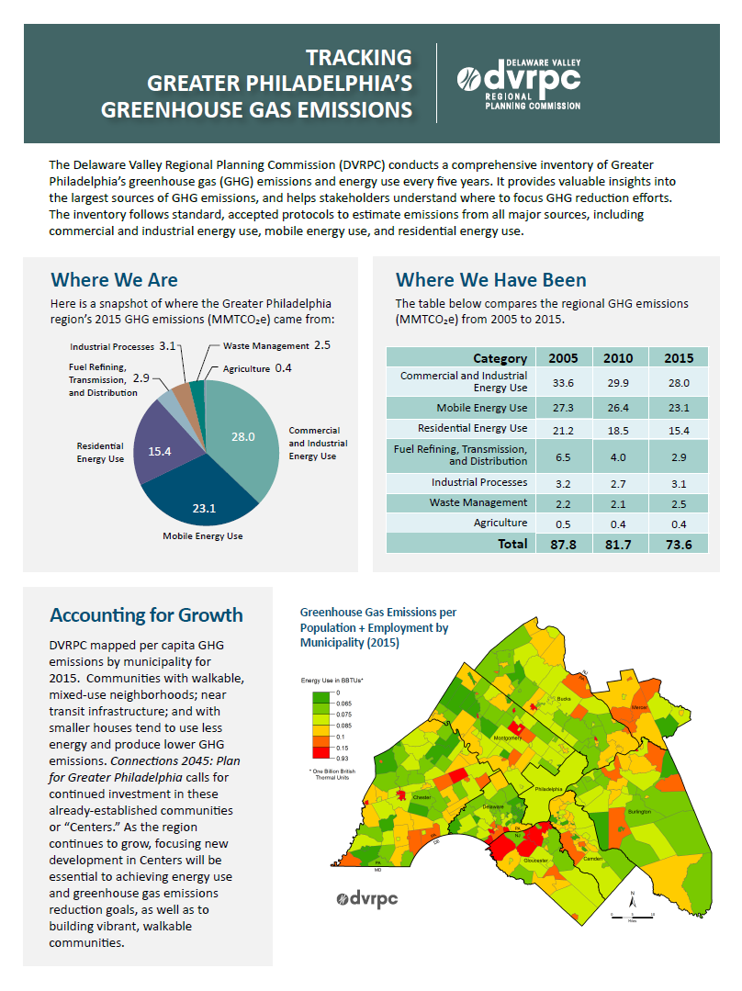
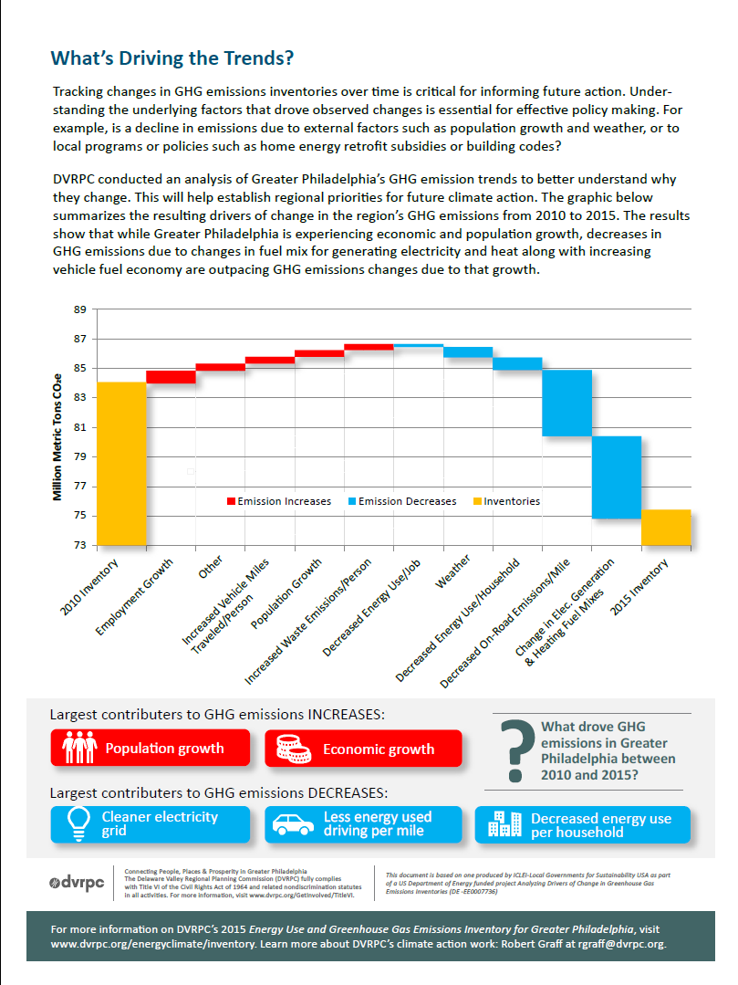
Notes:
. . . a nice, easy to understand, two-sided document summarizing GHG emissions in our region.

Slide 50
Thank You!
Questions?
Contact: Robert Graff
rgraff@dvrpc.org 215-238-2826

Slide 51
Thank You!
Contact info:
Eli Yewdall: eli.yewdall@iclei.org
Maia Davis: mdavis@mwcog.org
Rob Graff: rgraff@dvrpc.org
Eli Spang: eli.spang@narc.org
National Association of Regional Councils

